Slide 1
WhatsApp Chat Analyser
Khirod Sahoo
Anushka Singh
Ananya Sharma
Aishwarya Singh

Slide 2

Project Overview
WhatsApp Chat Analyser
WhatsApp is one of the most commonly used mode of communication. It has more than 2 billion users worldwide. An average user spends more than 195 minutes per week on WhatsApp.
We aim to analyse WhatsApp chats to generate insights about the activity in group chats or 1:1 chats. The user is anyone who would like to create a clean dataframe from a WhatsApp text file or see information like the number of messages, participant activities, sentiment of the chat and various visualizations that help understand what is going on in the chat file.
Notes:
I believe all of us use whatsapp every day, and it is undoubtedly the most commonly used method of communication today. There’s a lot you can tell about a person if you can analyse the whatsapp chats .. for instance, how active they are on whatsapp, how frequently do they text, what are the emotions behind the texts, most commonly used words in the chat and so on …

Slide 3
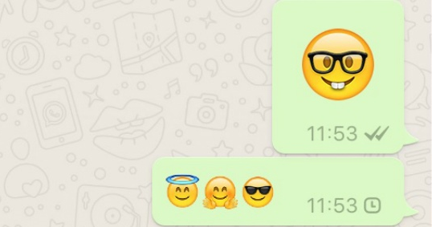
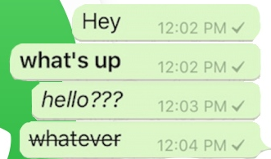

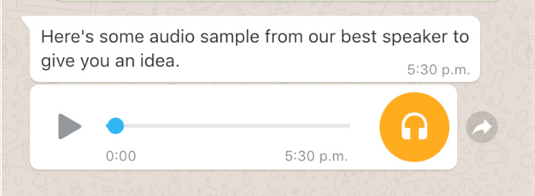
Project Overview
WhatsApp Chat Analyser
Most commonly used mode of communication
Includes text, emojis, images, gifs, audio messages
Perform cleaning, visualization, and sentiment analysis on the input chat
Emojis
Text Sample
Images/Videos/gifs
Audio message
Notes:
Mention that we will focus only on text data and emojis as a part of this

Slide 4
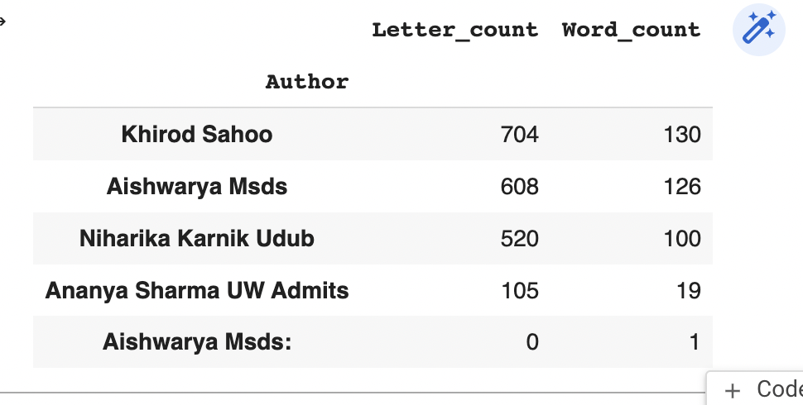
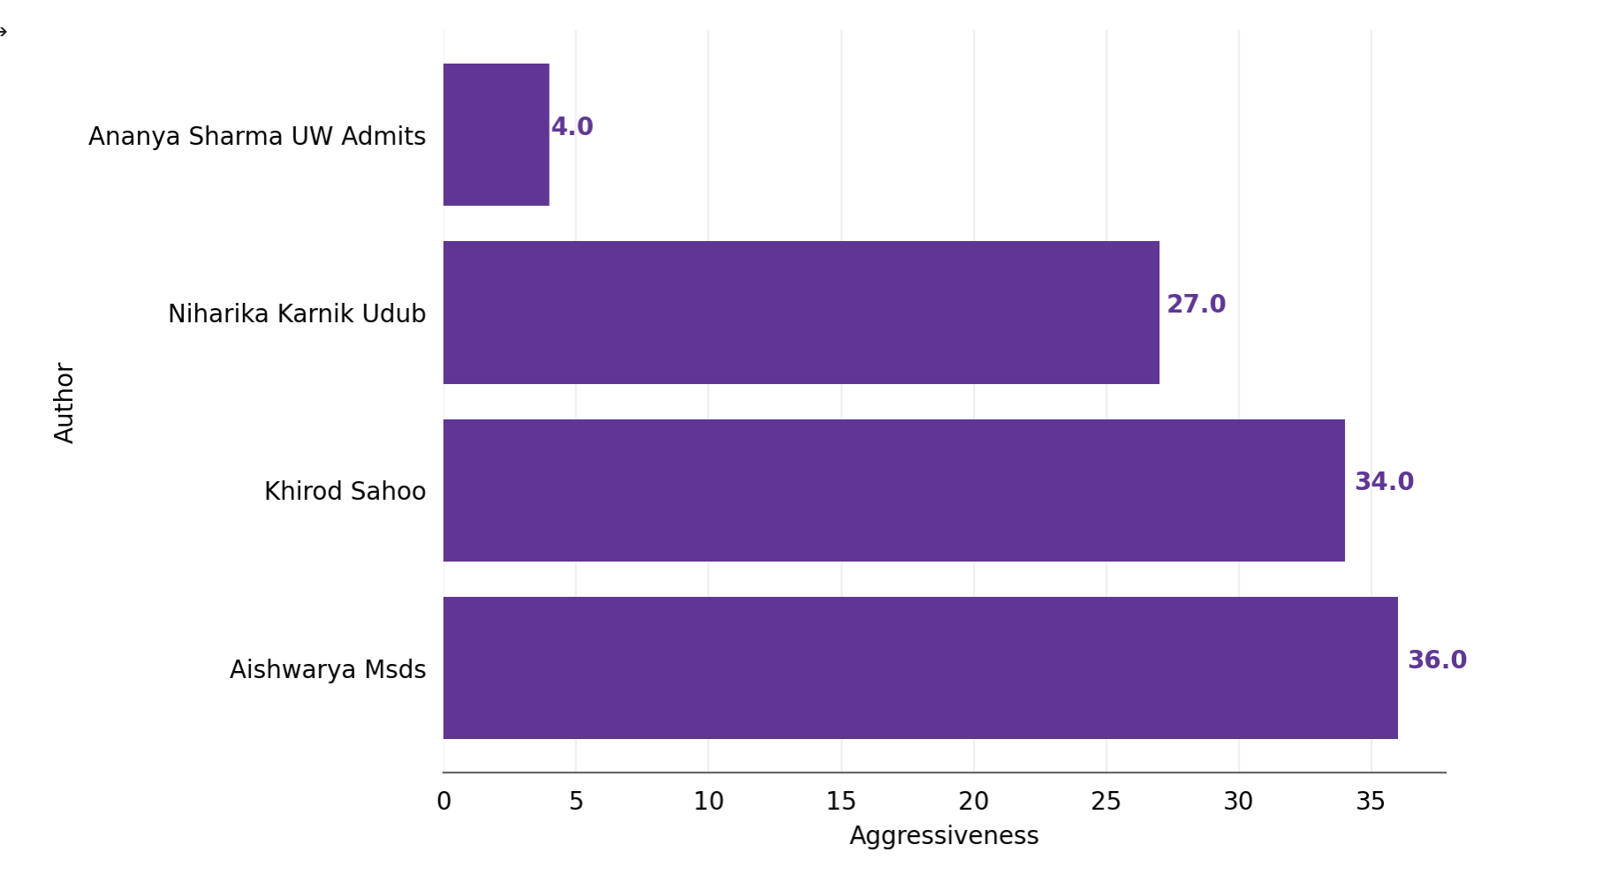
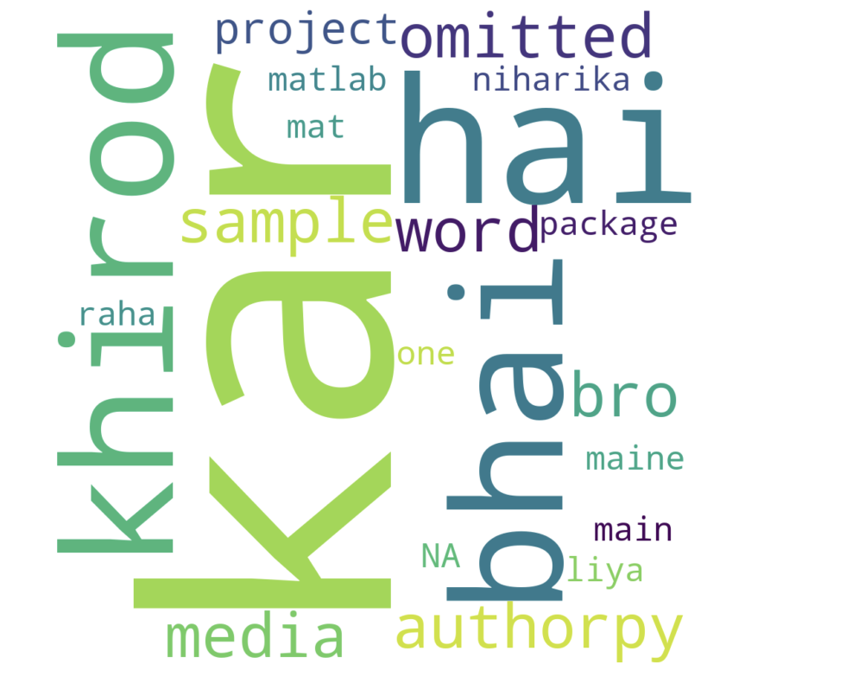
Project Overview
WhatsApp Chat Analyser
Most commonly used mode of communication
Includes text, emojis, images, gifs, audio messages
Perform cleaning, visualization, and sentiment analysis on the input chat
Analysing WhatsApp Chat examples:
Charts
Wordcloud
Statistics

Slide 5
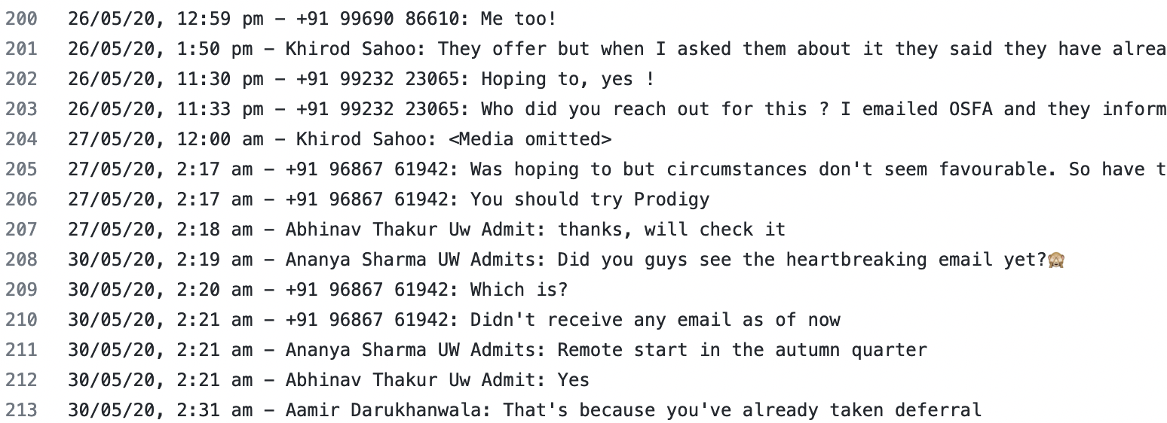
Data Description
WhatsApp Chat Analyser
Format: WhatsApp chat exported as .txt file
User1_masked
User2_masked
User4_masked
User4_masked
User2_masked
User3_masked
User3_masked
User5_masked_username
User5_masked_username
User7_masked
User7_masked
User6_masked_username
User5_masked_username

Slide 6
Data Description
WhatsApp Chat Analyser
Format: WhatsApp chat exported as .txt file
User1_masked
User2_masked
User4_masked
User4_masked
User2_masked
User3_masked
User3_masked
User5_masked
User5_masked_username
User5_masked_username
User6_masked
User7_masked
User7_masked
User6_masked_username
User6_masked
User5_masked_username
User5_masked
Notes:
Various data cleaning steps required - dealing with the time stamp, having random media omiited strings, presence of emojis in the chat and so on …

Slide 7
Project Flow
WhatsApp Chat Analyser
Input
▪ Whatsapp Chat File
▪ Format: txt

Slide 8
Project Flow
WhatsApp Chat Analyser
Data Cleaning
Cleaning Messages
▪ Clean date-time Variable
▪ Extract Author Names
▪ Extract Messages
Input
▪ Whatsapp Chat File
▪ Format: txt
▪ Removing symbols
▪ Deleting media
▪ Removing stopwords

Slide 9
Project Flow
WhatsApp Chat Analyser
Chat Analyser
Data Visualization Sentiment Analysis
Statistics
Data Cleaning
Cleaning Messages
▪ Clean date-time Variable
▪ Extract Author Names
▪ Extract Messages
▪ Bar Plot
▪ Pie Chart
▪ Generate wordcloud
▪ Positive score
▪ Negative score
▪ Neutral score
Input
▪ Whatsapp Chat File
▪ Format: txt
▪ Removing symbols
▪ Deleting media
▪ Removing stopwords
▪ No. of messages
▪ No.of media files shared
▪ Frequency of text

Slide 10
Package Structure
WhatsApp Chat Analyser
WhatsApp-Chat-Analyser
WhatsAppChatAnalyser
LICENSE
README.md
pyproject.toml
requirements.txt
setup.cfg

Slide 11
Package Structure
WhatsApp Chat Analyser
WhatsApp-Chat-Analyser
WhatsAppChatAnalyser
tests
__init__.py
LICENSE
README.md
author.py
pyproject.toml
group.py
whatsapp_text_cleaner.py
requirements.txt
whatsapp_chat_visualizer.py
setup.cfg
whatsapp_chat_sentiment.py

Slide 12
Package Structure
WhatsApp Chat Analyser
WhatsApp-Chat-Analyser
WhatsAppChatAnalyser
tests
Test_data.csv
__init__.py
__init__.py
LICENSE
author.py
test_group.py
README.md
group.py
test_whatsapp_chat_sentiment.py
pyproject.toml
whatsapp_text_cleaner.py
requirements.txt
whatsapp_chat_visualizer.py
setup.cfg
whatsapp_chat_sentiment.py

Slide 13

Design Decisions
…….
Our project has been developed in a way that is easy to understand, easy to debug and extendable. This would make the code reusable and maintainable. We have followed PEP 8 Style Guide for Python and added docstrings to the modules in order to make it easy for the readers/future users of this package to understand the functionality. Version control has been taken care of by GitHub.

Slide 14
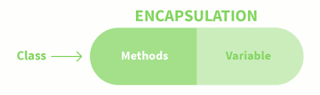
Design Decisions
…….
Encapsulation:
We have two classes author.py and group.py which contain the attributes that would be characteristic of a typical WhatsApp chat on a participant level and a group level. These include the name of the participant/group, message string, start and end dates of the chat.
We further have function definitions that allow the user to get some typical information about this particular class that include "get_statistics", "get_text_info" among other methods that return information related to the chat.

Slide 15
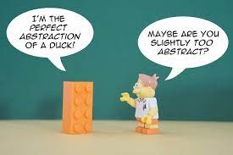
Design Decisions
…….
Abstraction:
The feature engineering and the in-depth functionalities within the methods - such as cleaning the chat text, sentiment calculation, creating visualizations from the data metrics such as the number of messages per author, plotting the bar graphs, the word cloud, is being taken care of without user interaction. Thus, the methods are a black box for the user who give the text file as input and get these pieces of information as the output.

Slide 16

Design Decisions
…….
Modular code:
The package is split into multiple modules - classes, separate module for visualization, text cleaning, and sentiment calculation - and each module has their own set of defined functions. These functions are responsible for their specific operations and interact with each other when required. The modules are defined as deep modules and perform complex functionality compared to the invocation effort.

Slide 17
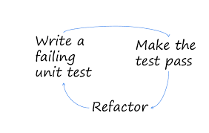
Design Decisions
…….
Test-driven development:
We have attempted test-driven development in certain modules where we have conceptualized the working of a method, written its unit test using unittest framework of Python, and then formed the modules, the function definition, and finalized the input and output accordingly. This also helped when we wanted to refactor the methods by making sure that we don't end up introducing bugs in the system.

Slide 18
GitHub Repository
…….
Link to the GitHub Repository:
https://github.com/aishwarya-singh25/WhatsApp-Chat-Analyser
Package Installation:
pip install -i https://test.pypi.org/simple/ whatsapp-chat-analyser

Slide 19

Future Scope
…….
Introduce a user friendly interface where they can just upload the text file and get results directly without having to code.
Enhancing the scope of the project to text files other than WhatsApp chats. We would need 2 inputs from the users asking them for the text file and which app it came from.
The current module returns a clean dataframe with the engineered features. In the future, we would include multiple dataframes summarized at different levels to make further analysis easier.
Extending the user base to developers by modifying the object that the function returns.

Slide 20
Thank you
…….

Slide 21
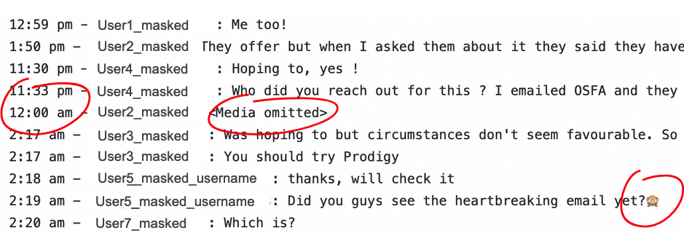
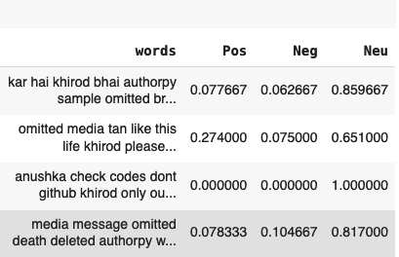
Data Cleaning
Statistics
Visualization
Sentiment Analysis

